Slide 1
Sentiment Classification of
Animal Crossing Reviews
Kasey La

Slide 2
Data
Animal Crossing Reviews (Kaggle, 2020 - sourced from Metacritic)
Three-way classification task: Positive, Neutral, Negative
Binned raw score of 0-3 for Negative, 4-6 for Neutral, and 7-10 for Positive
Reviews in multiple languages – majority are in English
2999 total instances
Sentiment | Review
Negative | One island per switch. I have to let my little sister play and i have to stay player 2
Neutral | The 2 players experience is terrible. I would recommand this game to a person with no friends, or family.
Positive | Super fun game. I do question Tom Nook's predatory lending practices. I owe him more than I do my actual bank.

Slide 3
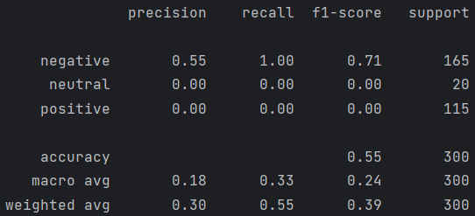

Modeling
Models:
Naive Bayes
Logistic Regression
Random Forest Classifier
Features:
Unigrams without stop words, punctuation, or spaces
Bigrams without punctuation or spaces
Hyperparameters:
Naive Bayes - alpha
Logistic Regression - C, penalty, solver, max_iter
Random Forest Classifier - max_depth, n_estimators, max_features
Using accuracy as the primary metric
Baseline accuracy for unigram feature set:
Most frequent class: 0.55
Logistic Regression: 0.84
Most frequent class
Logistic Regression

